Slide 1
Inspection Overview: Accomplishments and Goals
2017 AWW&WEA Conference
Jason Bolenbaugh
Compliance Branch, Office of Water Quality
May 1, 2017

Slide 2
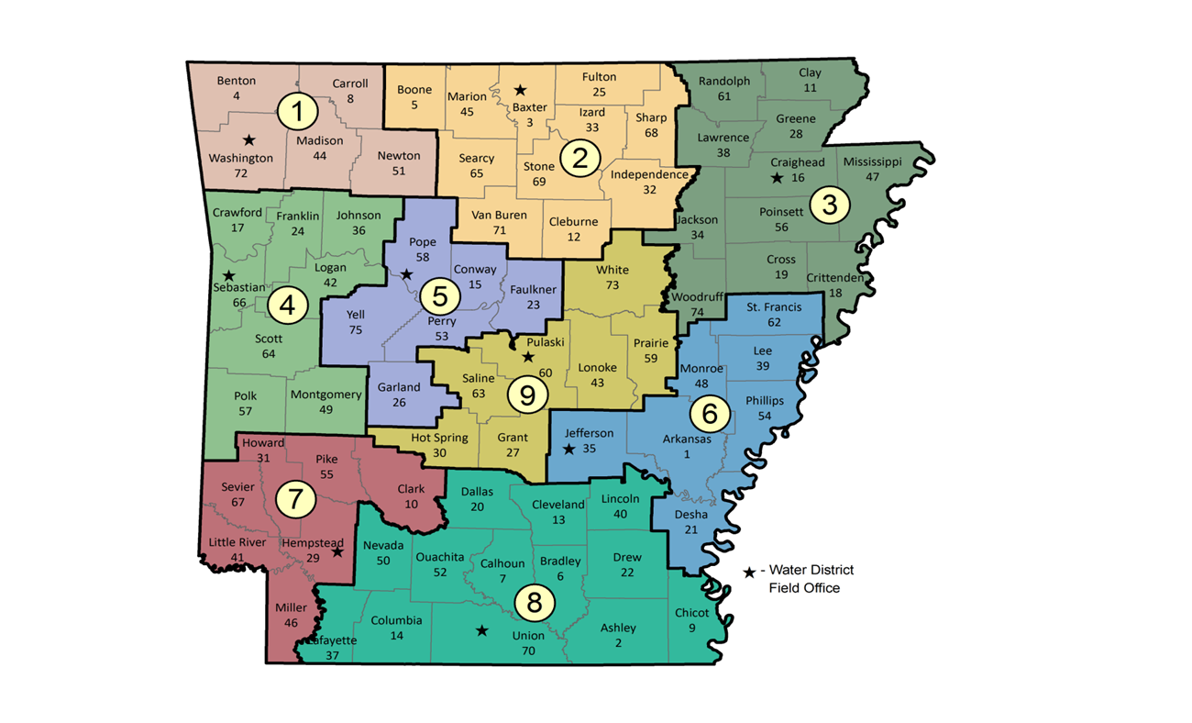
FIELD OFFICES & PERSONNEL
8 District Field Offices
20 Field Inspectors (4 Oil & Gas)
2 Supervisors, 2 Administrative Specialists, and 1 Manager

Slide 3
Inspection Types
Compliance Evaluation
Compliance Sampling
Collection System/SSO
Pretreatment
Stormwater
  Construction
  Industrial
  MS4
Complaints
STAA
Fish Kills
Spills/Emergency Resp.
State Permits
Compliance Assistance
Water Routes

Slide 4
Why Are You Being Inspected?
Scheduled
  Individual Discharge Facilities
    Majors
    Minors
  Pretreatment Inspections & Audits
  Stormwater Permits
    MS4 Audit
    Construction & Industrial
  General Permits
  State No-Discharge Permits
*Schedules may vary

Slide 5
Why Are You Being Inspected?
Complaint Based
  Receive hundreds of complaints
  Inspection type will vary
Requested
  Permits: Failure to Renew, Newly Permitted
  Legal: Ongoing Case/Current Conditions
  Enforcement: Radar, CAP Completion
  You (Compliance Assistance)

Slide 6
Focus Areas
Reviewed 2014 EPA CMS Requirements
Identified Areas for Improvement
  Individual Discharge Permits
    Majors - 113
    Minors - 667
    Collection System/SSO
  Pretreatment Inspections
  MS4 Audits
  Construction & Industrial Stormwater

Slide 7
Set Goals
Primary Goals → Individual Dischargers
  Inspect all identified facilities
  Develop a consistent schedule/rotation
  Collection System Evaluations
Secondary Goals
  Maintain CGP & IGP consistency
  Develop schedules for MS4 and Pretreatment
Complete by September 30, 2016

Slide 8
Individual Discharge Results
Consistency – YES • Quality – YES and NO
Quantity – YES • Compliance - Almost

Slide 9
Stormwater Takeaways
• CGP & IGP consistent and in compliance
• MS4 inconsistent and not in compliance

Slide 10
Pretreatment Inspections
Consistent
Compliant

Slide 11
Other Notables
1,034 Oil & Gas Inspections
>400 Complaints
>300 Others
>2,100 Water Samples
Provide Assistant
Must Prioritize – Please Be Patient

Slide 12

Fiscal Year 2017 and BEYOND
Refined Goals and Schedules
    CEI’s scheduled according to Permit Renewal
    2-year plan for majors
    5-year plan for MS4s
    5-year plan for PCIs (audits scheduled separately)
Increased consistency = increased compliance?
Increased Accountability
Decreased Confusion

Slide 13
Upcoming Years Schedules

Slide 14
Major Municipals
Ashdown
Beebe
Benton
Bentonville
Blytheville
Bryant
Cabot
Dequeen
Dumas
El Dorado (all 3)
Hot Springs
Jacksonville
Little Rock (Fourche Creek)
Magnolia
Maumelle
Monticello (East & West)
Nashville
North Little Rock (all 3)
Paragould
Pine Bluff
Rogers
Russellville
Searcy
Sherwood
Van Buren
Walnut Ridge
West Memphis

Slide 15
Major Industrials
AECC – Harry L. Oswald Generating Station
AECI Dell Power Plant
AEP-SWEPCO (Flint Creek)
Alcoa Inc. (Bauxite)
Bekaert Corporation
Clean Harbors (El Dorado)
Clearwater Paper Corporation (Cypress Bend Mill)
Entergy Arkansas, Inc. (Lake Catherine)
Entergy Arkansas, Inc. (White Bluff)
Entergy Arkansas, Inc. (Independence Plant)
Ervaz Stratcore, Inc.

Slide 16
Major Industrials
Futurefuel Chemical Company
Graphic Flexible Packaging, LLC.
Great Lakes Chemical Corporation (Central Plant)
Green Bay Packaging (Ark Kraft)
Halliburton Energy Services
KGEN Hot Spring, LLC.
Lion Oil Company (El Dorado)
Pine Bluff Arsenal
Remington Arms Company, LLC.
Southwestern Electric Power Co. (John W. Turk)
Union Pacific Railroad Company
Union Power Partners, LP (Union Power Station)

Slide 17
MS4 Audits
Fiscal Year 2017
Fiscal Year 2018
Alexander
Austin
Bella Vista
Bethel Heights
Brookland
Elkins
Elm Springs
Pine Bluff
Shannon Hills
Texarkana
UALR
Arkansas Highway Dep.
ASU
Bryant
Cave Springs
Crawford County
Farmington
Jacksonville
Jefferson County
Jonesboro
Little Rock
Rogers
Van Buren
Washington County

Slide 18
Pretreatment Compliance Inspections
Fiscal Year 2017
Fiscal Year 2018
Bentonville
Fort Smith
Hot Springs
Nashville
North Little Rock
Paragould
Rogers
Conway
El Dorado
Fayetteville
Harrison
Little Rock

Slide 19
Compliance Sampling Inspections
4 Major Municipals
4 Major Industrials
4 Minor Industrials
8 Minor Municipals
Facilities are picked from upcoming list
Will split samples with facility

Slide 20
Challenges
Turnover
  21 inspectors have left the Branch since 2012
    El Dorado, Fayetteville, North Little Rock, Mt. Home, Ft. Smith
    Staff have filled in when required or able
  Permittee has similar challenges
Training and Experience
  Takes time to gain knowledge
  Ranges from 14 years to weeks
    Inspectors notice different things
    Inspectors are encouraged to document the violations regardless of significance

Slide 21
CLOSING

Slide 22
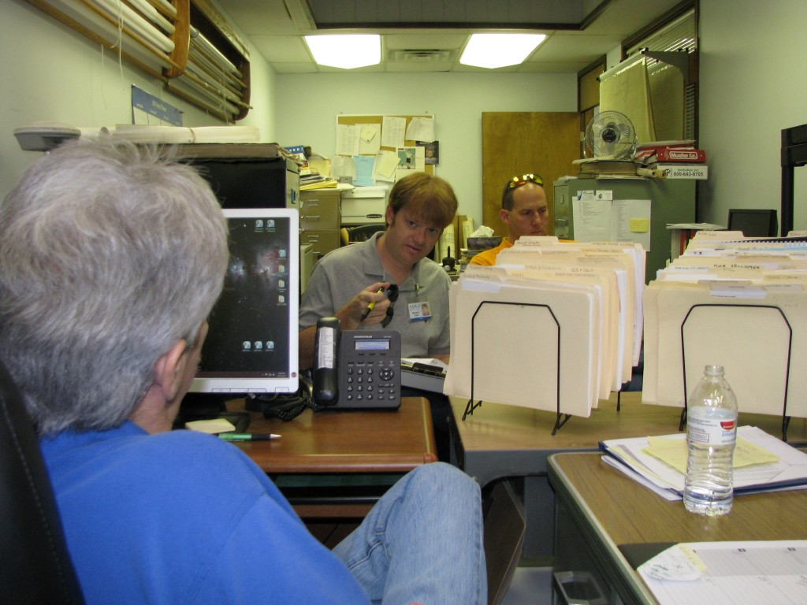
Working Together
Use the inspectors and inspections as a tool to improve your facility
  Convince Officials
  Obtain Funding
  Professional Achievement
Do not hesitate to call if you need assistance or have questions
Do not ignore requests for information
How Can We Assist?
GOAL FOR ALL IS COMPLIANCE

Slide 23
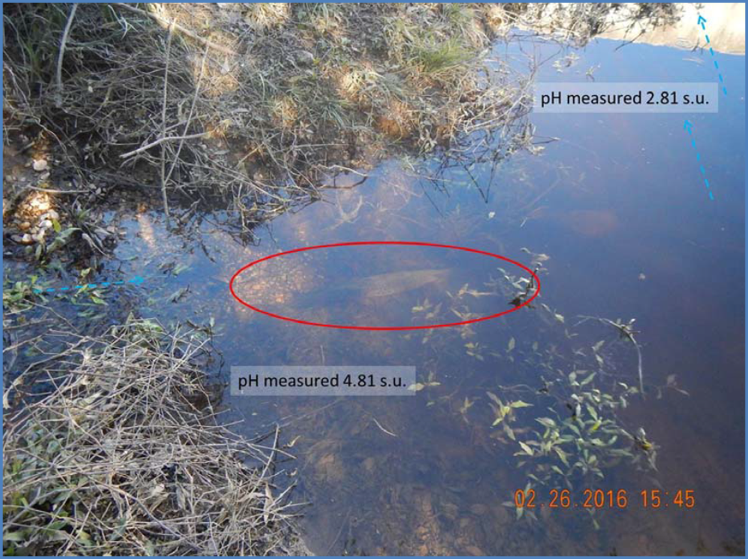

Slide 26

WHAT HAS BEEN YOUR EXPERIENCE?
Jason Bolenbaugh
501-682-0659
bolenbaugh@adeq.state.ar.us

